Slide 1
Model Validation

Slide 2
AIC / SBC/ AICC / “Hybrid” IC
“IC” = Information Criteria

Slide 3
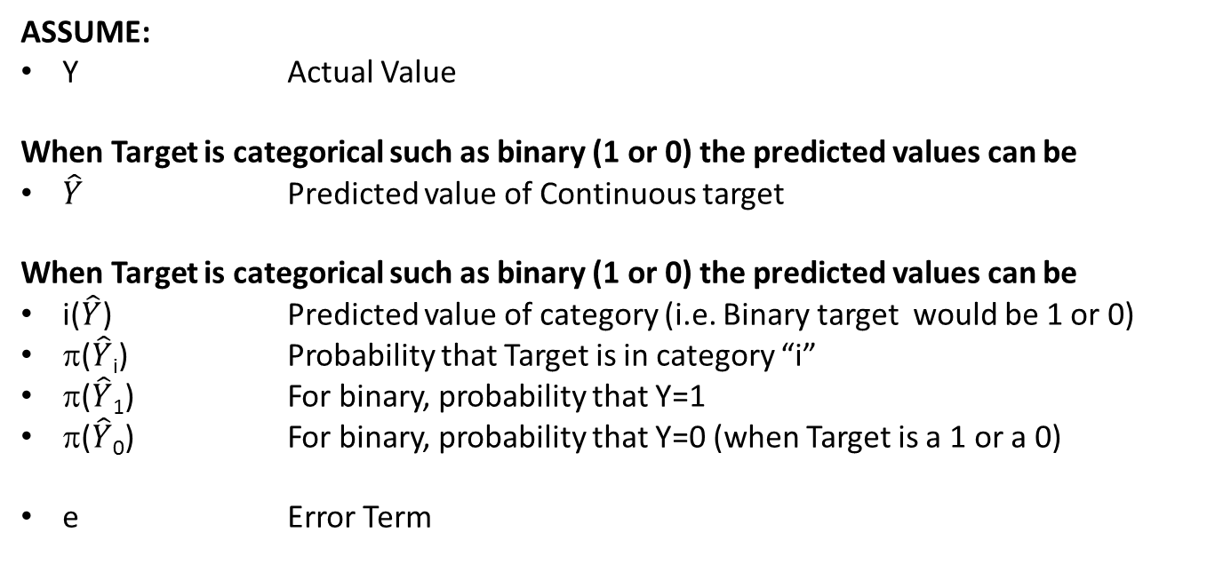
Information Criteria
ASSUME:
Y Actual Value
When Target is categorical such as binary (1 or 0) the predicted values can be
$\hat{Y}$ Predicted value of Continuous target
When Target is categorical such as binary (1 or 0) the predicted values can be
i($\hat{Y}\text{)}$ Predicted value of category (i.e. Binary target would be 1 or 0)
π($\hat{Y}$_{i}) Probability that Target is in category “i”
π($\hat{Y}$₁) For binary, probability that Y=1
π($\hat{Y}$₀) For binary, probability that Y=0 (when Target is a 1 or a 0)
e Error Term

Slide 4
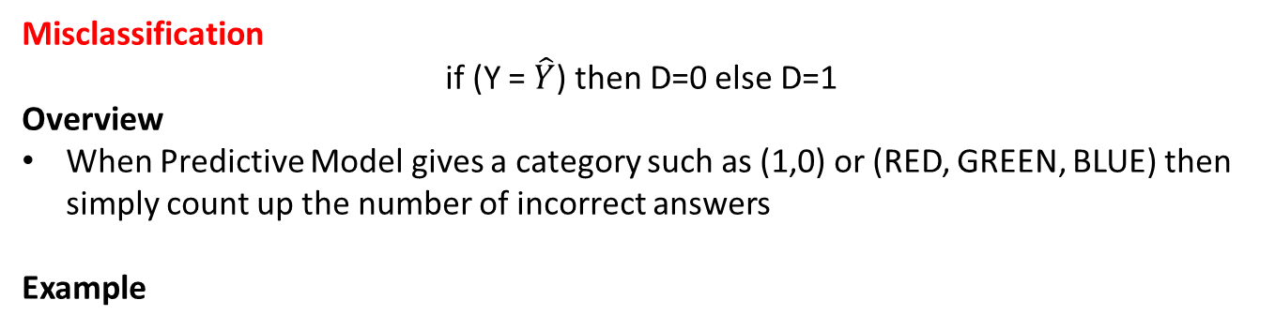
Information Criteria
Misclassification
if (Y = $\hat{Y}$) then D=0 else D=1
Overview
When Predictive Model gives a category such as (1,0) or (RED, GREEN, BLUE) then simply count up the number of incorrect answers
Example
Y (Actual) | Y-Hat (Predicted) | Misclassification
1 | 1 | 0
0 | 1 | 1
1 | 0 | 1
0 | 0 | 0

Slide 5
Information Criteria
Log Likelihood Deviance
D = -2*(Y ln(π₁) + (1-Y)(ln(π₀)))
Overview
Used when Predictive Model gives a probability (π) that the result is a 1 or 0.
Used extensively with Logistic Regression
Example
Y (Actual) | Prob of 1 (π₁) | Prob of 0 (π₀) | Log Likelihood
1 | 0.99 | 0.01 | 0.02
0 | 0.99 | 0.01 | 9.21
1 | 0.60 | 0.40 | 1.02
0 | 0.50 | 0.50 | 1.38
1 | 0.20 | 0.80 | 3.21
0 | 0.01 | 0.99 | 0.02

Slide 6
Information Criteria
AIC (“Akaike Information Criterion”)
SBC (“Schwarz Bayesian Information Criterion”)
AICc (“Adjusted Akaike Information Criterion”)
DKWIC (“Donald K Wedding Information Criteria”) … You can make up your own
Variables:
N Number of data points in the data set
K Number of terms in the model
D Deviation
Means Square Error
Misclassification Rate
Total Log Likelihood

Slide 7
Information Criteria
For the following metrics, assume that SAS reported the following for a LOGISTIC REGRESSION model
Variables:
N Number of data points in the data set = 100
K Number of terms in the model (including intercept) = 2
D The average deviation
Log Likelihood = -53.7494
-2*Log Likelihood = 107.353
Misclassifications = 26

Slide 8
Training Data Metrics
AIC (“Akaike Information Criterion”)
AIC = 2K + N ln( D )
EXAMPLE: Calculate AIC for several different types of models
(not comparing them against each other, just calculating AIC)
Note: For LOGISTIC REGRESSION, the Total Deviation “D” is typically used for the “N ln(D)” term. Therefore, The Logistic AIC value will be: 2K + D
Model | Deviation Metric | Total D | N | D | K | AIC
Classification Model | Misclassifications | 26 | 100 | 0.26 | 2 | -130.71
Logistic Regression | Maximum Likelihood | 107.353 | 100 | 107.353 | 2 | 111.35

Slide 9
Training Data Metrics
SBC (“Schwarz Bayesian Information Criterion”)
Greater penalty for complicated models
SBC = K ln(N) + N ln( D )
EXAMPLE: Calculate SBC for several different types of models
(not comparing them against each other, just calculating SBC)
Note: For LOGISTIC REGRESSION, the Total Deviation “D” is typically used for the “N ln(D)” term. Therefore, The Logistic SBC value will be: K ln(N) + D
Model | Deviation Metric | Total D | N | D | K | SBC
Classification Model | Misclassifications | 26 | 100 | 0.26 | 2 | -125.50
Logistic Regression | Maximum Likelihood | 107.353 | 100 | 107.353 | 2 | 116.56

Slide 10
Training Data Metrics
AICc (“Adjusted Akaike Information Criterion”)
Penalty for small sample sizes, avoids over fitting
AICc = 2K + N ln( D ) + 2K( K+1 )/(N-K-1)
EXAMPLE: Calculate AICc for several different types of models
(not comparing them against each other, just calculating AICc)
Note: For LOGISTIC REGRESSION, the Total Deviation “D” is typically used for the “N ln(D)” term. Therefore, The Logistic AICc value will be: 2K + D + 2K(K+1)/(N-K-1)
Model | Deviation Metric | Total D | N | D | K | AICC
Classification Model | Misclassifications | 26 | 100 | 0.26 | 2 | -130.58
Logistic Regression | Maximum Likelihood | 107.353 | 100 | 107.353 | 2 | 111.48

Slide 11
Training Data Metrics
DKWIC (“Donald K Wedding Information Criteria”)
You can customize your own information criteria to meet your needs … for example
+1 in LN() function prevents a negative value
K penalty increases logarithmically
Division by “N” allows for comparing of different sample sizes
DKWIC = (K ln(K) + ln( D+1 ) ) / ln(N)
EXAMPLE: Calculate DKWIC for several different types of models
(not comparing them against each other, just calculating DKWIC)
Model | Deviation Metric | Total D | N | D | K | DKWIC
Classification Model | Misclassifications | 26 | 100 | 0.26 | 2 | 0.35
Logistic Regression | Maximum Likelihood | 107.353 | 100 | 107.353 | 2 | 1.32

Slide 12
Concordant / Discordant Pairs

Slide 13
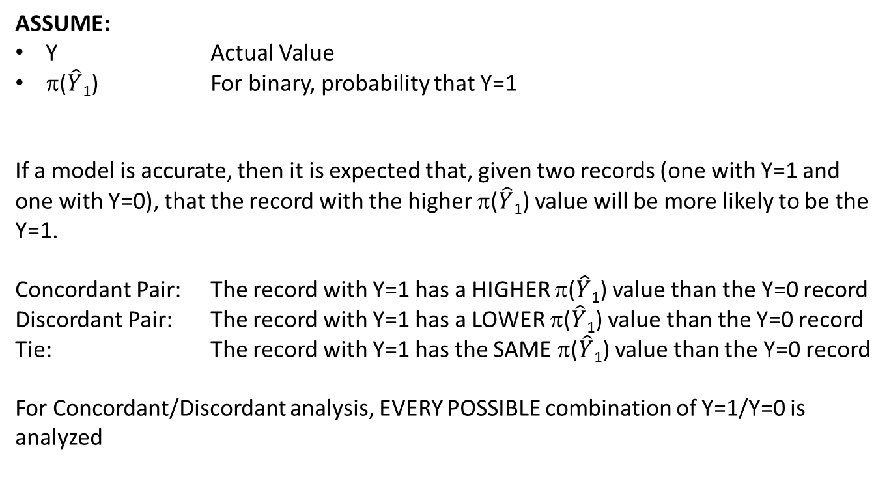
Concordant / Discordant Pairs
ASSUME:
Y Actual Value
π($\hat{Y}$₁) For binary, probability that Y=1
If a model is accurate, then it is expected that, given two records (one with Y=1 and one with Y=0), that the record with the higher π($\hat{Y}$₁) value will be more likely to be the Y=1.
Concordant Pair: The record with Y=1 has a HIGHER π($\hat{Y}$₁) value than the Y=0 record
Discordant Pair: The record with Y=1 has a LOWER π($\hat{Y}$₁) value than the Y=0 record
Tie: The record with Y=1 has the SAME π($\hat{Y}$₁) value than the Y=0 record
For Concordant/Discordant analysis, EVERY POSSIBLE combination of Y=1/Y=0 is analyzed

Slide 14
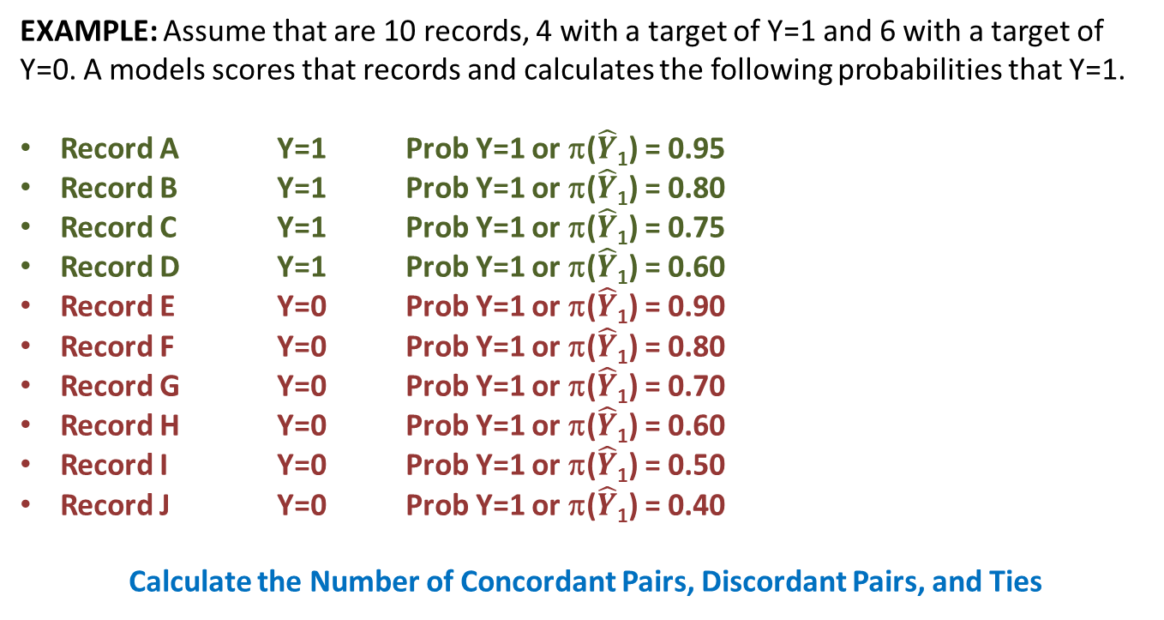
Concordant / Discordant Pairs
EXAMPLE: Assume that are 10 records, 4 with a target of Y=1 and 6 with a target of Y=0. A models scores that records and calculates the following probabilities that Y=1.
Record A Y=1 Prob Y=1 or π($\hat{Y}$₁) = 0.95
Record B Y=1 Prob Y=1 or π($\hat{Y}$₁) = 0.80
Record C Y=1 Prob Y=1 or π($\hat{Y}$₁) = 0.75
Record D Y=1 Prob Y=1 or π($\hat{Y}$₁) = 0.60
Record E Y=0 Prob Y=1 or π($\hat{Y}$₁) = 0.90
Record F Y=0 Prob Y=1 or π($\hat{Y}$₁) = 0.80
Record G Y=0 Prob Y=1 or π($\hat{Y}$₁) = 0.70
Record H Y=0 Prob Y=1 or π($\hat{Y}$₁) = 0.60
Record I Y=0 Prob Y=1 or π($\hat{Y}$₁) = 0.50
Record J Y=0 Prob Y=1 or π($\hat{Y}$₁) = 0.40
Calculate the Number of Concordant Pairs, Discordant Pairs, and Ties

Slide 15
Concordant / Discordant Pairs
RECORD “A” = 0.95 RECORD “E”= 0.90 CONCORDANT
RECORD “A” = 0.95 RECORD “F”= 0.80 CONCORDANT
RECORD “A” = 0.95 RECORD “G”= 0.70 CONCORDANT
RECORD “A” = 0.95 RECORD “H”= 0.60 CONCORDANT
RECORD “A” = 0.95 RECORD “I”= 0.50 CONCORDANT
RECORD “A” = 0.95 RECORD “J”= 0.40 CONCORDANT
RECORD “B” = 0.80 RECORD “E”= 0.90 DISCORDANT
RECORD “B” = 0.80 RECORD “F”= 0.80 TIE
RECORD “B” = 0.80 RECORD “G”= 0.70 CONCORDANT
RECORD “B” = 0.80 RECORD “H”= 0.60 CONCORDANT
RECORD “B” = 0.80 RECORD “I”= 0.50 CONCORDANT
RECORD “B” = 0.80 RECORD “J”= 0.40 CONCORDANT
RECORD “C” = 0.75 RECORD “E”= 0.90 DISCORDANT
RECORD “C” = 0.75 RECORD “F”= 0.80 DISCORDANT
RECORD “C” = 0.75 RECORD “G”= 0.70 CONCORDANT
RECORD “C” = 0.75 RECORD “H”= 0.60 CONCORDANT
RECORD “C” = 0.75 RECORD “I”= 0.50 CONCORDANT
RECORD “C” = 0.75 RECORD “J”= 0.40 CONCORDANT
RECORD “D” = 0.60 RECORD “E”= 0.90 DISCORDANT
RECORD “D” = 0.60 RECORD “F”= 0.80 DISCORDANT
RECORD “D” = 0.60 RECORD “G”= 0.70 DISCORDANT
RECORD “D” = 0.60 RECORD “H”= 0.60 TIE
RECORD “D” = 0.60 RECORD “I”= 0.50 CONCORDANT
RECORD “D” = 0.60 RECORD “J”= 0.40 CONCORDANT
CONCORDANT C=16
DISCORDANT D=6
TIE T=2

Slide 16
Concordant / Discordant Pairs
CONCORDANT C=16
DISCORDANT D=6
TIE T=2
Concordant %: Ranges from 0 to 1 and indicates the percent of pairs which are concordant.
= C / ( C+D+T )
= 16/(16+6+2 )
= 16/24
= 66.7%
C Statistic: Ranges from 0 to 1 and indicates the percent of pairs which are concordant. This is basically the same statistic as the concordant percent given above. The only difference is that this metric gives “half credit for “Tie Values”.
= ( C + 0.5*T ) / ( C+D+T )
= (16 +0.5*2 ) /(16+6+2)
= 17/24
= 0.708

Slide 17
Concordant / Discordant Pairs
CONCORDANT C=16
DISCORDANT D=6
TIE T=2
Sommers D: Ranges from -1 to +1. A value of +1 indicates perfect accuracy while a value of -1 indicates perfect failure. This is the same as Concordant %, but it adds a penalty term for each incorrect value.
= (C-D) / ( C+D+T )
= (16-6)/( 16+6+2 )
= 10/24
= 0.417
Gamma: Ranges from -1 to +1. A value of +1 indicates perfect accuracy while a value of -1 indicates perfect failure. This is the same as Sommer’s D, except that the “Tie Values” are ignored.
= (C-D) / ( C+D )
= (16-6)/(16+6 )
= 10/22
= 0.455

